Slide 1


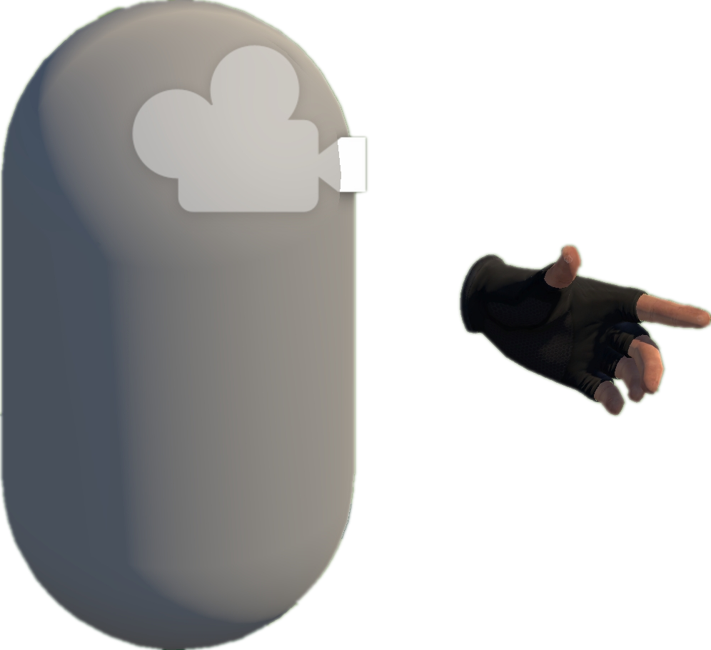









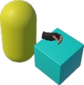
Project Collection
& Analysis (§ III-A)
D
VRExplorer Test (§ III-D)
A
3
Behavior Execution and Scene Exploration
Preliminary Scene Configuration
Collect By Tags & Topics
1
Camera
Open Source
Repositories
Bake NavMesh
Hand Controller
Unity-based
VR Projects
Original Scene
Scene with NavMesh (for navigation)
Collider
VRExplorer Agent
Hierarchy Analysis
Code Analysis
Implementation Interface
Hierarchy
All Scripts
2
Interaction & Scene Analysis
Environment
Core Logic Code & Third Plugin Analysis
Customizing Entity Interface Configuration
PFSM
Autonomous Event Invocation
Interactables
Box
Core Scripts
Task Execution
Scripts Implemented
Entity Interface
Decision Making
extract the
abstraction model
Task Execution
Autonomous
Event Invocation
Input Next
Interactable’s Mono
B
Model Abstraction (§III-B)
EAT Framework (§ III-C)
Output
Task
Model
C
Task Generator
Abstraction of Interactable Objects
Task Generator & Customized Task Model
Example of Task Model
Triggerable
Parallel and serial combinations
Button, Joystick
Triggerable & Grabbable
Grab-And-Drag-Box Task
Gun, Cigarette Lighter
Base Action
Inherit
Move to Approcach
Parallel Action
Inherit
Move Action
Grab Action
Grabbable
Box, Coin
Grab Action
Trigger Action
Grab
Move Action
Walk Around
Asynchronous Action
Abstraction of Actions
Grab
Base Entity
Trigger
Press
Pressing
Trigger Action
+ Triggering Time
+ Triggering() + Triggered()
Inherit
Inherit
Pressed
Grabbable Entity
Triggerable Entity
Pull
Pulling
Task Layer
Entity Interface
C# Scripts File
Relaxed
Action Layer
Fire
Pulling the trigger
Implement
Implement
Unity Scene
GameObjects
Triggered
Implement
Entity Layer
XR Box
XR Joystick
XR Button
Mono Scripts
Third Plugins
NavMesh Data
Notes:
单击此处添加文本

